Slide 1




"Hypothetically Speaking…"
The Role of Counterfactuals in Claims for Misleading or Deceptive Conduct
Tuesday, 24 February | 5:30 pm
SESSION SPEAKERS
Dinesh Ratnam
Andrew Girgis
Solicitor 2004 / Barrister 2015
Solicitor 2015 / Barrister 2021

Slide 2
Causation

Slide 3
Causation
Westpac Banking Corporation v Jamieson
[2016] 1 Qd R 495
“It may be sufficient for the plaintiff to simply prove that he or she would not have entered into the subject transaction. Policy or pragmatic considerations suggest that a plaintiff should not necessarily be required to prove what else he or she would have done. A requirement for such proof increases the complexity and costs of litigation by exploring alternative transactions, including investments, which were not seriously considered.”

Slide 4
Causation
Westpac Banking Corporation v Jamieson
[2016] 1 Qd R 495
“It is hard to see why, in point of principle, a court in assessing the appropriate measure of compensation for loss caused by the negligent and misleading advice should be required to ignore the fact that, absent the negligent advice about Company A, the plaintiff would have bought shares in Company B, and suffered loss on that investment in a declining share market.”

Slide 5
Causation
Berry v CCL Secure Pty Ltd 271 CLR 151;
[2020] HCA 27 at [72]
“A plaintiff must plead all material facts to constitute the cause of action, including any counterfactual on which that plaintiff relies to establish the requisite causal link between identified loss or damage and the cause of action”

Slide 6
Causation – An Essential Element

Slide 7
Causation – An Essential Element
Henville v Walker (2001) 206 CLR 459;
[2001] HCA at [106]
Material Contribution
Despite other factors playing a role
Material Contribution – Damage – Causal Connection
Abnormal Event – may not be the cause

Slide 8
Causation – An Essential Element
Sedgwick Australia Pty Ltd v JLOC Super Pty Ltd
[2024] QCA 218
What are the facts that establish the necessary causal link between the contravening conduct and claimed loss
What are the material facts on which the party relies to establish any counterfactual relied on to establish the requisite causal link
A reasonable inference
Procedural fairness – fair notice

Slide 9
Causation – An Essential Element
Graham & Linda Huddy Nominees Pty Ltd v Byrne
[2016] QSC 221 at [50] to [51]
Plead that the loss suffered – Commercial Opportunity
What would the plaintiff have done
Plead the proportion – UCPR (QLD)
If lost opportunity is 100% - Plaintiff has some work to do

Slide 10
TORT v CONTRACT v EQUITY

Slide 11
FACT of LOSS v VALUE of LOSS
Lloyd v Belconnen Lakeview Pty Ltd [2019] FCA 2177 at [345], [347] (Lee J)

Slide 12
FACT of LOSS v VALUE of LOSS
Graham & Linda Huddy Nominees Pty Ltd v Byrne
[2016] QSC 221
State the Counterfactual
Allege the loss it suffered on the possibilities

Slide 13
FACT of LOSS v VALUE of LOSS
Lantrak Holdings Pty Ltd v Yammine
[2023] FCAFC 156
Lee J at [17]
Jackman J at [289]

Slide 14
FACT of LOSS v VALUE of LOSS
Derrington J – Agreed!
Mining Standards International Pty Ltd
v
Atlantic Nickel Mineracao Ltda
(No. 4) [2025] FCA 777

Slide 15
The Statutory Framework

Slide 16
The Australian Consumer Law

Slide 17
Some Principles

Slide 18
Counterfactual

Slide 19
Pleading a Counterfactual
Berry v CCL Secure Pty Ltd 271 CLR 151;
[2020] HCA 27
Gageler and Edelman JJ stated:
“A plaintiff should be expected to plead all material facts on which the plaintiff relies to constitute the statutory cause of action, including any counterfactual on which that plaintiff relies to establish the requisite causal link between identified loss or damage and identified misleading or deceptive conduct. In the same way, a defendant resisting the statutory action should be expected to plead any different counterfactual on which that party might rely to deny the causal link. Unless and to the extent that the parties choose to depart from the pleadings in the way they go on to conduct the trial, choice between the competing pleaded counterfactuals on the balance of probabilities should then exhaust the fact-finding that is required to be undertaken by the court on the issue of causation.”

Slide 20
PROOF OF CAUSATION

Slide 21
Pleading a Counterfactual
R Lawyers v Mr Daily [2025] HCA 41
JUST PLEAD IT!

Slide 22
Pleading counterfactuals
General pleading principles
Misleading or deceptive conduct
In Berry v CCL Secure Pty Ltd (2020) 271 CLR 151; [2020] HCA 27, Gageler and Edelman JJ stated at [72] (citations omitted, emphasis added):
  A plaintiff should be expected to plead all material facts on which the plaintiff relies to constitute the statutory cause of action cause of action, including any counterfactual on which that plaintiff relies to establish the requisite causal link between identified loss or damage and identified misleading or deceptive conduct. In the same way, a defendant resisting the statutory cause of action should be expected to plead any different counterfactual on which that party might rely to deny the causal link...
In Denian Enterprises Pty Ltd v Northern Beaches Enterprises Pty Limited as trustee for the Northern Beaches Trust [2021] NSWSC 109, Davies J said at [53]
  The counterfactual needs to be pleaded to establish the causal link between the misleading and deceptive conduct and the loss claimed, as Berry makes clear. All of the defendants need to understand the basis of the claim the plaintiffs are making.

Slide 23
Pleading counterfactuals
General pleading principles
Negligence
In Clarke v GEO Australia Pty Ltd [2023] NSWSC 716 at [77], Rothman J observed:
  It is well-established law that a pleading of causation must go beyond a mere assertion that a defendant’s negligence led to a plaintiff suffering harm. A pleading must use material facts to establish the causal link which will be used at trial to sheet liability home to the defendant. The requirement to do so accords with the overarching purpose of the pleading to identify the issues to be tried.
In Owners – Strata Plan No. 91684 v Parkview Constructions Pty Ltd [2025] NSWSC 493 at [36] Stevenson J stated:
  ... the proposed pleading does not reveal how this result would have come about. It does not set out the likely credible sequence of events that would have led to this result. In particular, once again, the critical integer of what Parkview would have done is absent.

Slide 24
Pleading counterfactuals
General pleading principles
Different kinds of counterfactuals
“No transaction”
“Alternative” or “different” transaction – may be pleaded both by a plaintiff and defendant (i.e. defensively)
No strict requirement to establish a counterfactual as a ‘causal link’
There is no strict requirement to establish a counterfactual case.
Cummins Generator Technologies Germany GmbH v Johnson Controls Australia Pty Ltd (2015) 326 ALR 556; [2015] NSWCA 264, [133] (Beazley P, Gleeson and Leeming JJA agreeing)
Counterfactuals are a ‘useful’ tool to assist in establishing causation and loss.
Anchorage Capital Master Offshore Ltd v Sparkes (2023) 111 NSWLR 304; [2023] NSWCA 88, [381] (the Court)
Multiple counterfactual scenarios may be pleaded, but not required.
Richmond Valley Council v JLT Risk Solutions Pty Ltd [2022] NSWSC 1761, [130]-[131] (Williams J)

Slide 25
Pleading counterfactuals
Pleading the counterfactual
The ‘but for’ test is inherent in the ‘counterfactual analysis’.
Ask – was the wrongful act (misleading conduct, negligence etc) necessary for the loss?
As Edelman J explained in Lewis v Australian Capital Territory (2020) 271 CLR 192; [2020] HCA 26 at [178] (emphasis added)
    [T]he test for causation of loss asks whether the wrongful act was necessary for the loss. The ‘but for’ or counterfactual approach ‘directs us to change one thing at a time and see if the outcome changes’. The change is the removal of the wrongful act. If the loss would lawfully have occurred but for the wrongful act then the wrongful act was not necessary for the loss. The counterfactual approach thus involves a hypothetical question where no other fact or circumstance is changed other than those which constituted the wrongful act.
Another way of testing the position is to ask whether the plaintiff relied upon the relevant wrongful conduct.

Slide 26
Example Cases
Negligence
In Findlay v Victoria [2009] VSCA 294, Maxwell P stated at [2] (emphasis added):
  ... the causal link between the breach of duty and the claimed damage can only be established by means of a counterfactual hypothesis. That is, the plaintiff must propound an alternative state of facts premised upon the defendant’s having exercised reasonable care and, specifically, upon there having been no relevant failure to act. The plaintiff’s counterfactual hypothesis must identify:
  (a) what the defendant would have done had reasonable care been exercised; and
  (b). how the taking of that action (or those actions) would have averted the loss or damage which the plaintiff in fact suffered
In Sergienko v AXL Financial Pty Ltd [2019] NSWSC 1610 at [52], Ward CJ in Eq (as the President then was) stated (emphasis added):
  … [T]he failure of the pleading to identify the risk of harm and the reasonable precautions against that risk that is said were required gives rise to difficulties in relation to the case on factual causation under s 5D(1)(a). What the plaintiff must do is to identify the likely credible sequence of events which would have occurred but for the breach..

Slide 27
Example Cases
Misleading or deceptive conduct (continued)
In Boulus Constructions Pty Ltd v Warrumbungle Shire Council [2020] NSWSC 1847, Stevenson J observed at [13]-[14] in relation to a contended “alternative” or “different” transaction case:
[13] … to prove that the parties would have entered a contract that was from Boulus’s point of view “better” than the Contract, Boulus would have to “show that the [Council] would have accepted [Boulous’s] revised tender”: that is, the Counterfactual Tender.
[14] To make out a “different” or “better” contract case, Boulus would have to plead the facts on which it relies to show that the Council would have accepted the Counterfactual Tender, and thus enter the Counterfactual Contract

Slide 28
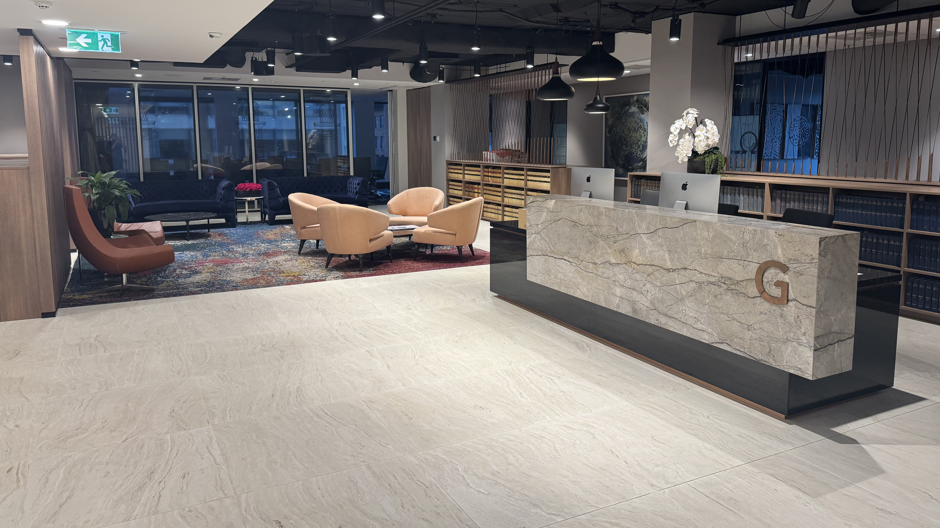
Questions?
VIVAMUS MASSA JUSTO CONSECTETUR VEL CONDIMENTUM SIT AMET
28

Slide 29



Contact us
+61 2 9151 2999
clerk@greenway.com.au
Level 10
99 Elizabeth St
Sydney NSW 2000
VIVAMUS MASSA JUSTO CONSECTETUR VEL CONDIMENTUM SIT AMET
29

