Slide 1
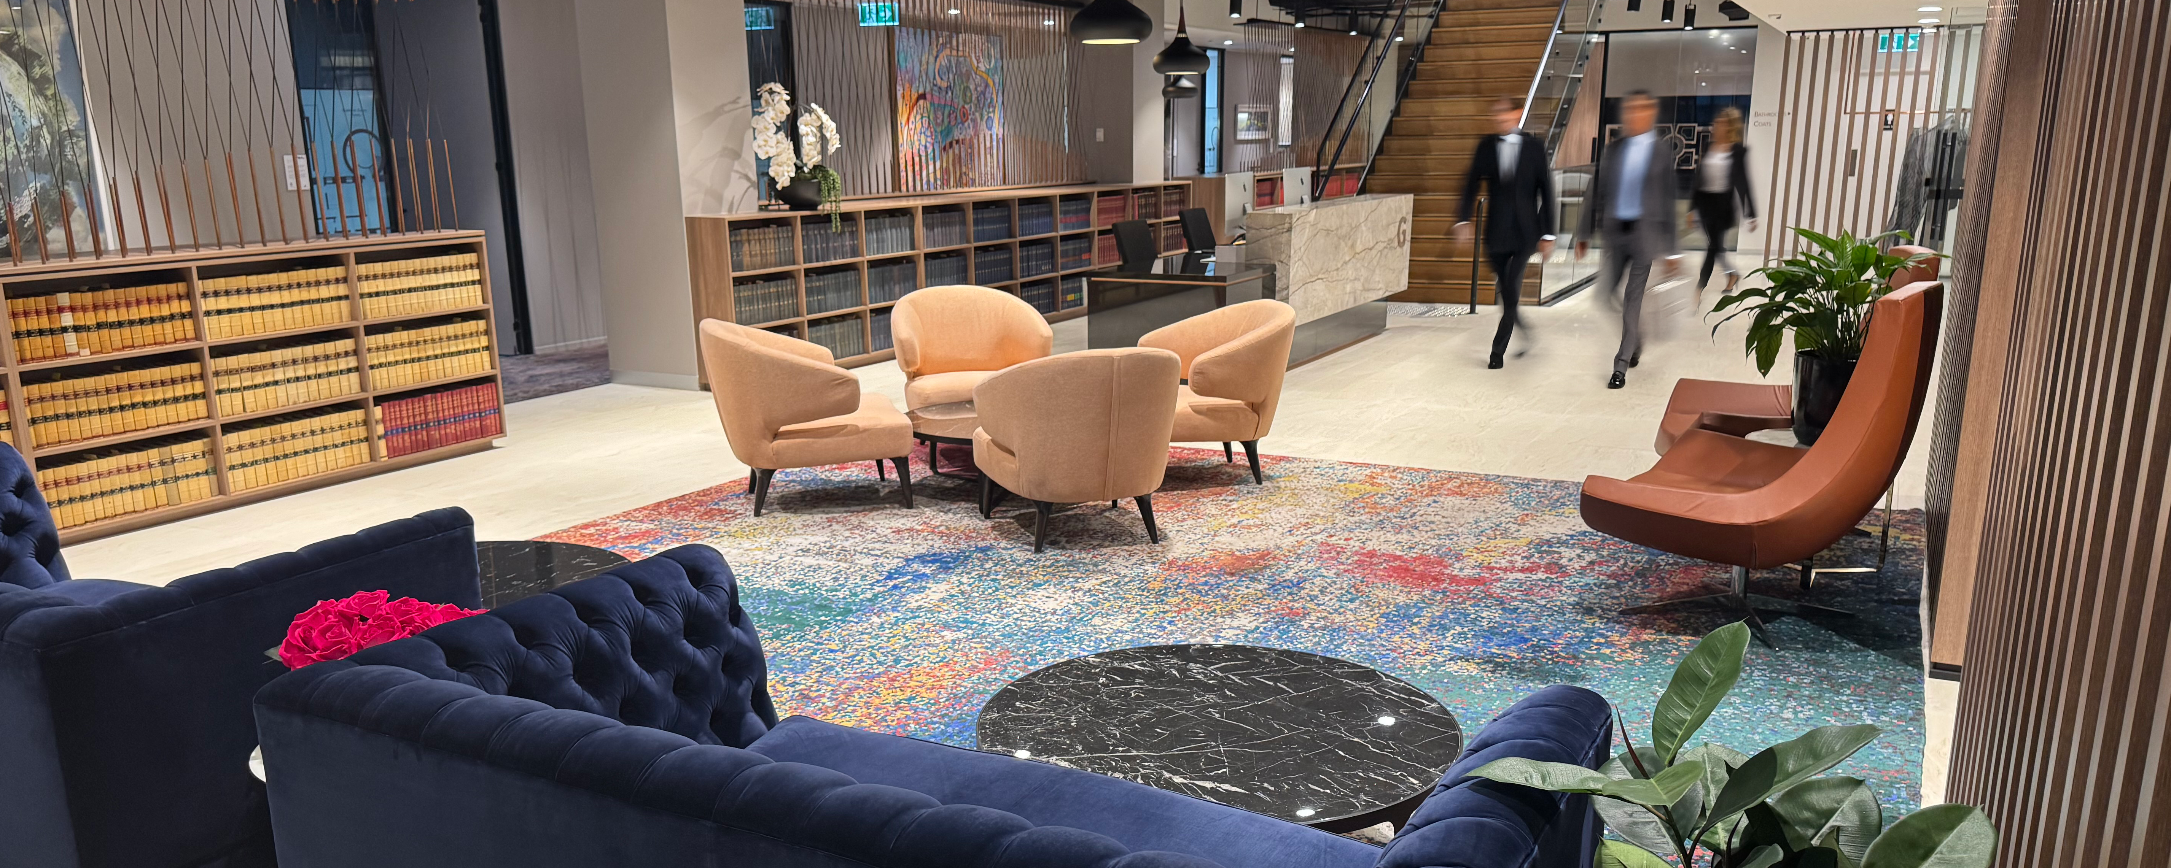


Coronial Inquests and Inquiries
The Coroner’s Court: A Unique Jurisdiction
17 February 2026
SESSION SPEAKERS
Richard Sergi
Barrister 1994

Slide 2
Settings
Legislation
Coroners Act 2009 (NSW) – commencement 19 June 2009
Explosions
Electrocutions
Incarceration
Police operations
Medical and psychiatric misadventure
Hospital and community

Slide 3
Coroner’s Jurisdiction
Jurisdiction arises in two scenarios
  Section 19
  Section 21 – jurisdiction where:
    person’s death reportable; or
    there is no medical certificate as to cause of death
  Section 30 - fire or explosion.
Reportable deaths
  Section 6(1)(a) – violent or unnatural deaths
  Section 6(1)(b) – sudden deaths or deaths from unknown causes
  Section 6(1)(c) – deaths from suspicious or unusual circumstances
  Section 6(1)(e) – deaths not reasonably expected outcome or health procedure
  Section 6(1)(f) – deaths while temporarily absent from mental health facility

Slide 4
Jurisdiction is Unique
A hybrid inquisitorial and adversarial – Musumeci v Attorney General of NSW (2003) 57 NSWLR
Neither criminal nor civil – Green v state Coroner of New South Wales (unreported) SCNSW, Sully J 19 November 1997, BC9708037
Exercise judicial power, notwithstanding the executive nature of their functions – Musumeci v Attorney General of NSW (2003) 57 NSWLR
Counsel assisting
No right of appearance – s 57

Slide 5
Purpose of Proceedings
Questions to be addressed:
  Who – s 81(1)(a) – identity
  When – s 81(1)(b) – time
  Where – s 81(1)(b) – place
  How – s 81(1)(c) – manner and cause
  What occurred – s 81(1)(c) – manner and cause
  Recommendations – s 82 – unfettered discretion – can similar deaths be prevented in future
Letter from the Coroner

Slide 6
Distinction Between Manner and Cause of Death
Illustration
Death following a fall
  cause – injuries from the impact
  manner – a jump, a slip, a push

Slide 7
Evidence
Coroner can conduct inquest or inquiry adopting procedures as
he or she sees fit
s 58(1): A coroner in coronial proceedings is not bound to observe the rules of procedure and evidence that are applicable to proceedings before a court of law.
Flexible procedures.
Hearsay and opinion evidence can be presented and relied upon.
Parties cannot use rules of evidence to exclude unfavourable evidence.
But can make submissions about reliability of certain evidence.
Touchstone of admissibility – relevance subject always to procedural fairness and natural justice
Standard of proof – Briginshaw v Briginshaw (1938) 60 CLR 336.

Slide 8
Serious Adverse Event Reviews –
Root Cause Analyses
Prohibition on adducing evidence of ”serious adverse event review”
21P Advice and reports not to be admitted in evidence
(1) Evidence as to the contents of an advice or report of an incident reviewer cannot be adduced or admitted in any proceedings
  Health Administration Act 1982, Part 2A, s 21P (formerly Part 2, Division C – root cause analysis)
  Private Health Facilities Act 2007, Part 4, s 49F
Query practice of Court seeking provision of serious adverse event review (ie. RCA)
  21O Information not to be given in evidence
    (1) A person is neither competent nor compellable to produce any document or disclose any communication (or to disclose any information that the person obtained from any such document or communication) to a court, tribunal, board, person or body if the document was prepared, or the communication was made, for the dominant purpose of the exercise of a function under this Part by an incident reviewer.
Private Health Facilities Act 2007, Part 4, s 49E

Slide 9
Directions Hearings
Section 49 – speedy determination of real issues
  Leave to appear
  Issues
  Witnesses
  Expert reports
  Non-publication orders
  timetables

Slide 10
Witness Preparation
Psychological preparation
Forensic preparation
  Manner and cause – how – what occurred – prevention of similar deaths
Drafting statements
  Overriding objective – avoiding oral evidence
  Grasp the nettle
  Privilege against self-incrimination

Slide 11
Witness Preparation
(continued)
Oral evidence
  Identify problematic conduct – grasp the nettle
  Address problematic conduct – strategy
    Ensure the witness understands the problem
    Inform the witness of the strategy
    Consider how issue is addressed
    Explain the protection of a certificate
    Remind the witness to be frank
    Object to evidence – obtain a certificate

Slide 12
Procedure at Hearing
Opening address – background and nature – issues – witnesses – evidence to be presented
Is client’s preparation consistent with opening
Lines of communication

Slide 13
Sections 58, 61 – Privilege Against Self- Incrimination
Witnesses cannot be compelled to give:
  Answers tending to incriminate – s 58(2)(a)
  Answers tending to make witness liable to a civil penalty – s 58(2)(b)
Objection – s 61
  Purpose – adduce evidence going to issues while protecting witness in relation to other proceedings
  The correct approach – general, global objection not permitted – question by question, topic by topic
  Rich v Attorney General of NSW [2013] NSWCA 419 per Court of Appeal
  Equivalent provision – s 128 Evidence Act 1995 (NSW)

Slide 14
Relevant Criteria for
Granting Certificate
Criteria for granting of certificate
  Importance of evidence
  Whether witness a person of interest
  Nature and subject matter of inquiry
  Nature and extent of witness’s jeopardy
  Whether evidence will be unreliable if not given
  Alternative source of evidence
  Correll v Attorney General of NSW [2007] NSWSC 1385 at [29] per Bell J

Slide 15
Two further matters re section 61
Section 61(7)(b) – caveat to protection – no application to proceedings going to falsity of the evidence to which certificate applies
Section 61(6) – Coroner obliged to give a certificate if an objection to giving evidence was overruled and has given evidence

Slide 16
Non-Publication Orders
Sections 74-76 Coroners Act 2009
“public interest”
  An interest common to the public at large or a significant proportion of the public and which may or may not involve the personal or proprietary rights of individual people.
General principles – Mirror Newspapers v Waller (1985) 1 NSWLR 1

Slide 17
Apologies and Family
Statements
Apologies
  Instructions required
  Usually, little forensic or legal difficulty with an apology: nb. s 69 Evidence Act 1995 (NSW)
Family statements
  Cathartic opportunity
  State Coroner’s Protocol on Family Statements, 8 September 2025 – read in conjunction with practice note, Coronial Practice no 1 of 2018

Slide 18
Recommendations
Object of the Act – s 3(e)
Power – s 82
Public health and safety – ss 3(e), 82(2)(a)
Local Court Bench Book – pragmatism recommended
  Practical and concrete
  Realistic
  Credible
  Consistent

Slide 19
Review
Section 85 CA
Reasons must be provided
Error of law must be demonstrated
  Conway v Jerram, Magistrate and NSW State Coroner [2011] NSWCA 319

Slide 20
Other Documents
Local Court Bench Book – Practice Notes – Protocol for First Nations People
Coronial Practice No.1 – general procedural requirements and management
Coronial Practice Note 2 – critical incidents
Coronial Practice Note No.3 – s 23 CA – deaths in custody or police operations
State Coroner’s Protocol – supplementary arrangements applicable to s 23 deaths (in custody or police operations) involving First Nations People
State Coroner’s Protocol on Family Statements
Premier’s Memorandum 2009-2012 Responding to Coronial Recommendations
NSW Health Policy Directive 2010_054 Coroners Cases and the Coroners Act 2009

Slide 21
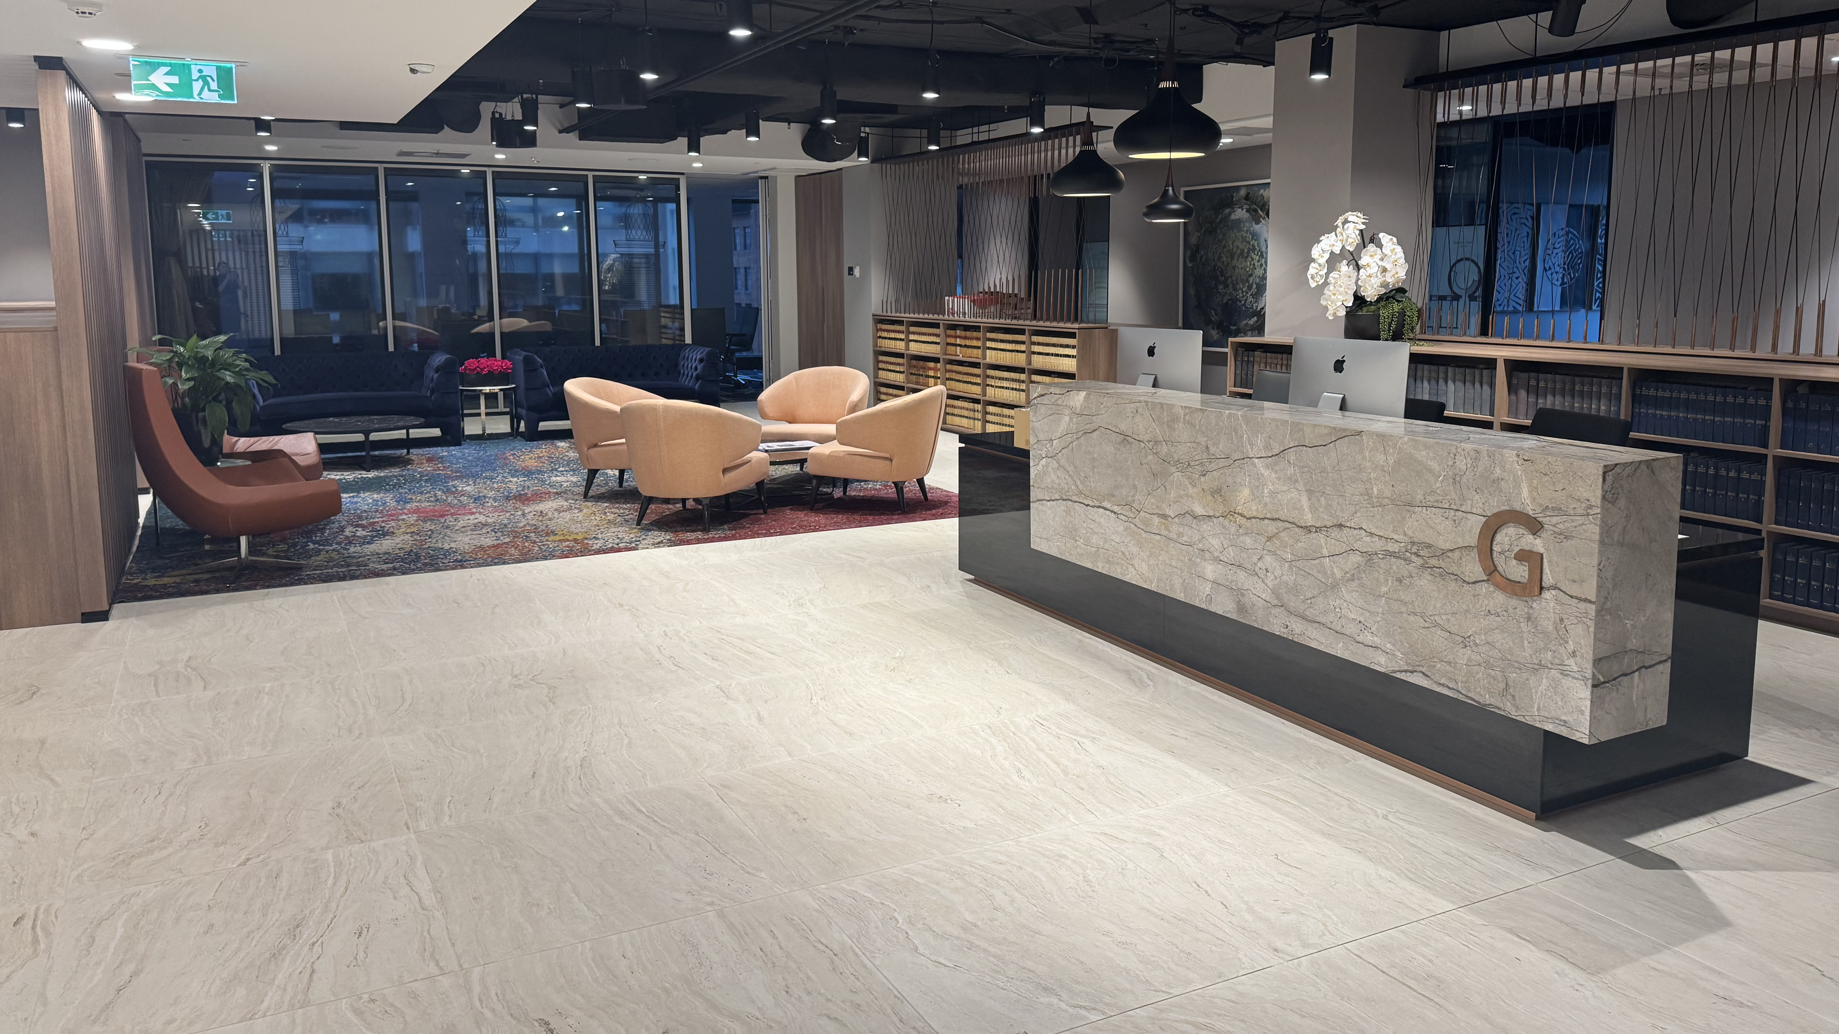
Questions?
VIVAMUS MASSA JUSTO CONSECTETUR VEL CONDIMENTUM SIT AMET
21

Slide 22



Contact us
+61 2 9151 2999
clerk@greenway.com.au
Level 10
99 Elizabeth St
Sydney NSW 2000
VIVAMUS MASSA JUSTO CONSECTETUR VEL CONDIMENTUM SIT AMET
22

